Slide 1

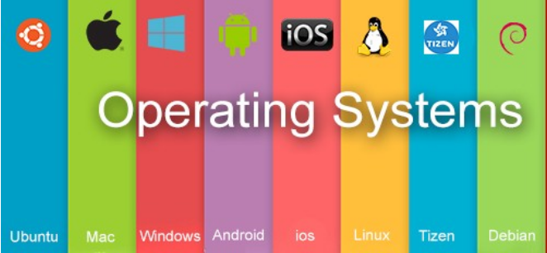
Operating System BCSC0004
Ajitesh Kumar
Assistant Professor
GLAU

Slide 2
Multithreading, System Call and OS Kernel

Slide 3
Important Terminology
Multiprogramming
Residing of more than one program in RAM
No Role of CPU
UNI Programming- Single Program
Degree of Multiprogramming() = n

Slide 4
Important Terminology
2. Multitasking
Logical Extension of multiprogramming where CPU time is divided into minute interval
Each interval is allocated to each process and the cycle repeats-Time Sharing
No Parallelism , Single CPU

Slide 5
Important Terminology
3. Multiprocessing
Simultaneous or parallel execution of more than one program on more than one CPU
Parallelism , Multiple CPU

Slide 6
Important Terminology
4. Multiuser
If OS support multiple user to simultaneously execute their program on single common
shared OS.

Slide 7
5. Multithreading
Combination of multiple treads
THREAD- Sub process(Sub part) of a process/program
E.g. Calculator Program (Add, Sub, Mul, etc….)
Individually each of these are sub part/ sub process of calculator process
No of lines in calculator process is greater than its any individual sub process
Threads- Light Weight Code

Slide 8
Multithreading
Calculator -- Parent process
Sub Part(Add/Sub)--- Child process(Threads)
Simultaneously execution of more than one threads is called multithreading.
Child Process must be complete before completion of parent process.
ZOMBIE / ORPHAN

Slide 9
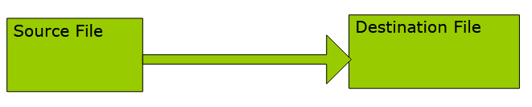
Child Process/ Sub process/ Threads
How to create-
System call used by application program to request services of OS(memory management, process management, device management, file management etc.).
System calls provide an interface to the services made available by an operating system.
Ex: Writing a simple program to read data from one file and copy them to another file.
System Call(build in defined system function)- fork()

Slide 10
Fork()
Whenever you encounter fork(), it will duplicate all the remaining program following the fork() line.
E.g.
Printf “GLA”
output-GLA
1 line
No child process
Only parent process
Total No. of Process-01

Slide 11
Fork()
2. fork()
Printf “GLA”
output-GLA GLA
2 line
One child process
One parent process
Total No. of Process-02
3. fork()
fork()
Printf”GLA”

Slide 12
Fork() system call
Fork system call is used for creating a new process, which is called child process, which runs concurrently with the process that makes the fork() call (parent process).
After a new child process is created, both processes will execute the next instruction following the fork() system call.
A child process uses the same pc(program counter), same CPU registers, same open files which use in the parent process.
Below are different values returned by fork().
Negative Value: creation of a child process was unsuccessful. Zero: Returned to the newly created child process. Positive value: Returned to parent or caller. The value contains process ID of newly
created child process.

Slide 13
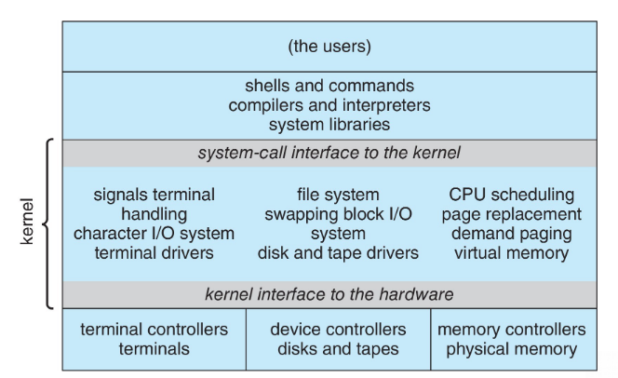
Kernel User Mode vs Kernel Mode

Slide 14
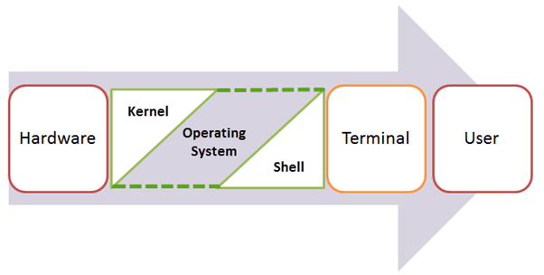
What is Kernel in Operating System?
Kernel is central component of an operating system that manages operations of computer and hardware. It basically manages operations of memory and CPU time.
Kernel loads first into memory when an operating system is loaded and remains into memory until operating system is shut down again.
It is responsible for various tasks such as disk management, task management, and memory management.

Slide 15
There are many types of kernels that exists, but among them, the two most popular kernels are:
1.Monolithic
A monolithic kernel is a single code or block of the program. It provides all the required services offered by the operating system. It is a simplistic design which creates a distinct communication layer between the hardware and software.
2. Microkernels
Microkernel manages all system resources. In this type of kernel, services are implemented in different address space. The user services are stored in user address space, and kernel services are stored under kernel address space. So, it helps to reduce the size of both the kernel and operating system.

Slide 16
Monolithic Kernel
It is one of types of kernel where all operating system services operate in kernel space.
It has dependencies between systems components. It has huge lines of code which is complex.
Unix, Linux, Open VMS, XTS-400 etc.

Slide 17
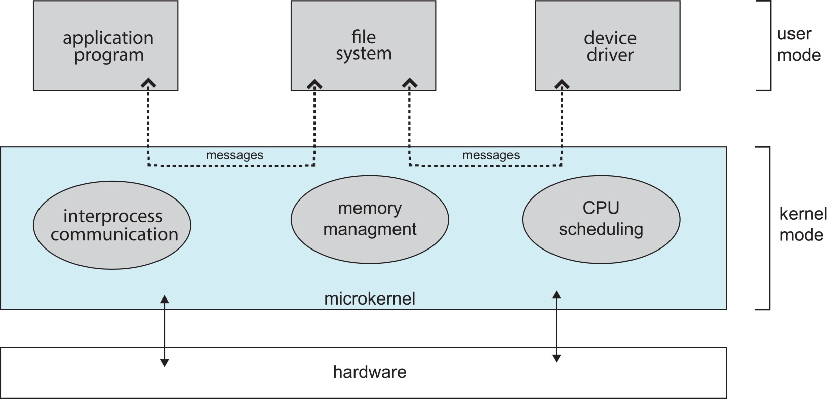
Micro Kernel
It is kernel types which has minimalist approach.
It has virtual memory and thread scheduling.
It is more stable with less services in kernel space. It puts rest in user space.
Mach, L4, AmigaOS, Minix, K42 etc.

Slide 18
Features of Kennel
Low-level scheduling of processes
Inter-process communication
Process synchronization
Context switching

Slide 19
Question
1. Which of the following is not an operating system?
Windows
Linux
Oracle
DOS
2. When was the first operating system developed?
1948
1949
1950
1951
3. Which of the following is the extension of Notepad?
.txt
.xls
.ppt
.bmp

Slide 20
4. What else is a command interpreter called?
prompt
kernel
shell
Command
5. BIOS is used?
By operating system
By compiler
By interpreter
By application software
6. What is the mean of the Booting in the operating system?
Restarting computer
Install the program
To scan
To turn off

